Slide 1
WELCOME
WM-AWMA 2023 Spring Conference
Compliance and Beyond: Navigating a Changing Regulatory Landscape
SPONSORED BY:

Slide 2
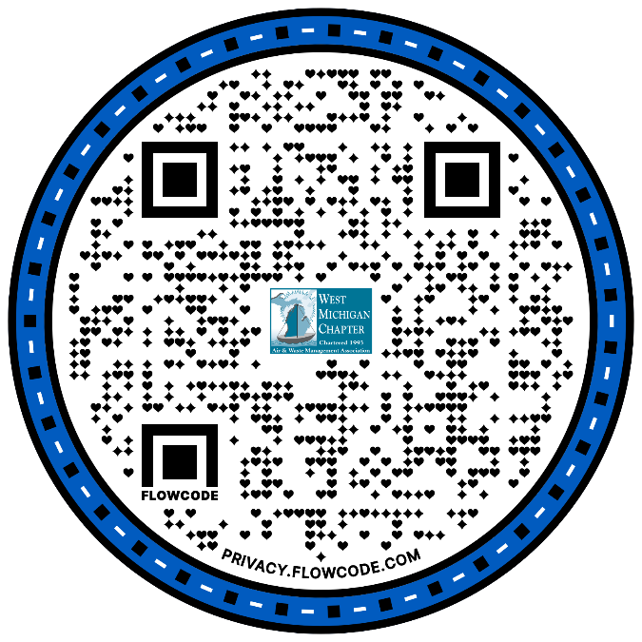
AGENDA:
BIOGRAPHIES:

Slide 3
Technology: Fleis & VandenBrink Engineering Breakfast: Plummer’s Environmental
Networking Break: Brown and Caldwell Lunch: NTH Consultants, Ltd. Raffle Prize: MillerKnoll Happy Hour: Fishbeck

Slide 4
2023 Spring Conference Exhibitors:
Brown and Caldwell
Eco-Rental Solutions
Eurofins Environment Testing
Fishbeck
Fleis & VandenBrink Engineering, Inc.
Haley & Aldrich
Pace®
Plummer's Environmental
RWDI
Taplin Group

Slide 5
WM-AWMA 2023 CORPORATE SPONSORS
GOLD
PLATINUM
Barnes & Thornburg LLP
Covanta
Fishbeck
Lacks Enterprises, Inc.
Meijer
Rhoades McKee PC
Warner Norcross + Judd
SET Environmental
Taplin Group
SILVER
ADAC Automotive
Adler Tank Rentals
Amway
Barr Engineering Co. Brown & Caldwell Consumers Energy
Environmental Partners, Inc.
ERG Environmental Services
Fleis & VandenBrink
GZA GeoEnvironmental
Haley & Aldrich Kent County Department of Public Works MillerKnoll
NTH Consultants, Ltd.
Paragon Laboratories, Inc.
RWDI Steelcase Inc.
Vicinity Energy
Wolverine Power Cooperative
BRONZE
CFR, L.L.C.
Eco-Rental Solutions
Environmental Resources Group
Eurofins Environment Testing America Pace®
Plummer’s Environmental Services
Varnum

Slide 6
WM-A&WMA Corporate Sponsor Anniversaries
20 Years

Slide 7
WM-A&WMA Corporate Sponsor Anniversaries
20 Years

Slide 8
WM-A&WMA Corporate Sponsor Anniversaries
15 Years

Slide 9
WM-A&WMA Corporate Sponsor Anniversaries
10 Years

Slide 10
WM-A&WMA Corporate Sponsor Anniversaries
10 Years

Slide 11
WM-A&WMA Corporate Sponsor Anniversaries
5 Years

Slide 12
WM-A&WMA Corporate Sponsor Anniversaries
5 Years

Slide 13
WM-AWMA 2023 Scholarship Recipients
Ethan Coffin
Graduate School at Western Michigan University
Major: Doctor of Philosophy in Geosciences Environmental Engineering
Susan Toppen
Junior, Michigan State University
Major: Environmental Studies and Sustainability
Minor: Environmental Economics

Slide 14
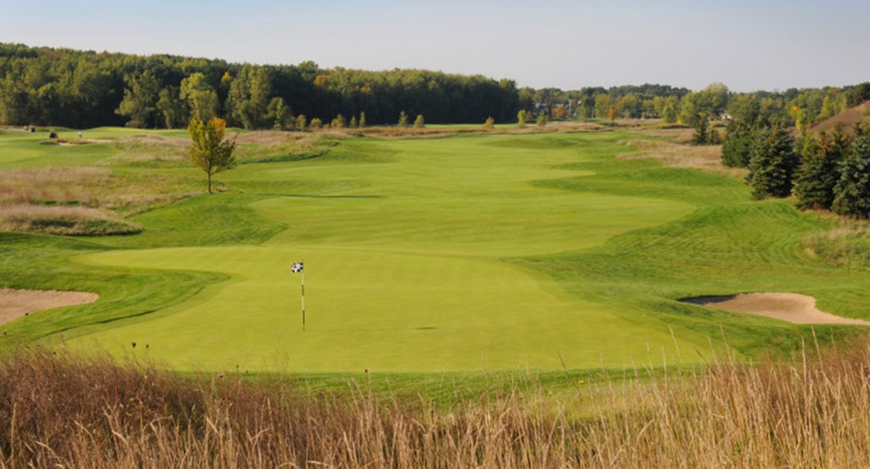
Upcoming WM-AWMA events:
May 31, 2023
ANNUAL TECHNICAL SESSION &
GOLF OUTING / SCHOLARSHIP FUNDRAISER
The Meadows @ GVSU in Allendale
ESG, Sustainability, and Carbon Management
10:00 a.m. - 12:00 p.m.
Nicole L. Nguyen, PMP, PE - Barr Engineering
Linda M. Hilbert, PE - Consumers Energy
Lawrence Meredith - Grand Valley State University
Brittany Szczepanik - Positive Scenarios Consulting, LLC
12:00 – 1:00 p.m. Networking Luncheon; 1:00 p.m. Golf (nine holes) (optional)
June 5-8 – Air and Waste Management Association’s 116th Annual Conference & Exhibition (ACE) in Orlando, FL.
Smart Growth: Balancing Development, Restoration, and Resiliency

Slide 15
Your raffle ticket is good for a complimentary drink during Happy Hour, immediately following the raffle drawing. Please grab a second ticket for a second complimentary drink if you wish!
Raffle Sponsor:
Happy Hour Sponsor:

Slide 16
2023 Spring Conference Planning Committee:
Heidi Hollenbach, EGLE (Chair)
Trista Gregorski, Holland Board of Public Works
Linda Hensel, Environmental Resources Group
Jessica Huizenga, Amway
Jackie Linck, Fishbeck
Chris Occhipinti, NTH Consultants
Scott Plummer, JOST International
Andrea Schwartz, Wolverine Worldwide
Thank you to Fishbeck for providing the sponsorship poster boards.

