Slide 1
West Michigan AWMA AQD Enforcement Update Jenine Camilleri, AQD Enforcement Supervisor April 26, 2023
Notes:
Good afternoon, thank you for having me come to speak at Clearing the Air, I am happy to be here to share some accomplishments, updates and what is coming next for the AQD.

Slide 2
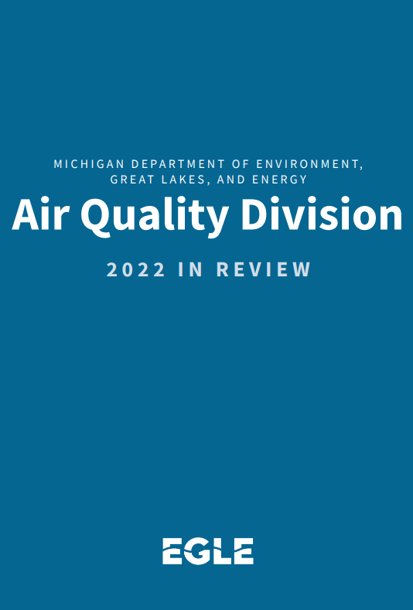
Air Quality Division 2022 Accomplishments
Pre-construction permit actions = 570
Renewable Operating permit actions = 45
Inspections = 929
Air Complaints Received and Resolved = 2,482
Monitored outdoor air at over 43 sites, with 100+ monitors​
Emission reports received from industry = 1,600+​
Asbestos removal notifications received = 69,176
Asbestos inspections completed = 1,726
Violation notices issued = 433
Enforcement cases = 27
Over 19,000 email list subscribers
Notes:
The AQD Year in Review for 2022 has been released and is available on our website
Each year the AQD presents our Annual Report documenting our accomplishments from the previous year. This year’s report, included some of the following highlights:
Increased FTE cap from 194 to 209
Pre-construction permit actions = 570 (includes all actions on applications) with 20 public comment required
Renewable Operating permit actions = 45 (with 86 ROP mods)
Inspections = 929 (ROP and non-ROP, excluding asbestos)
Monitored outdoor air at 43 (40-45 fluctuates) sites, with over 100 monitors​, monitoring for over 13 pollutants/parameters, 8 meteorological parameters (number of sites changes as we remove or add sites)
Emission reports received from industry = around 1600 slightly less than last year​
Asbestos removal notifications received = 69,176 compared to 39,777 in FY21
Asbestos inspections completed = 1,726 compared to 2,034 last year
Violation notices issued = 433 comparted to 348 from last year = both compliance from field visits as well as from asbestos inspections
Enforcement cases = 27 compared with 28 from last year
19000 email subscribers between Air Quality news and MAERS
We are proud to have so many accomplishments in a year that was challenging, as we transition to a hybrid workplace.

Slide 3
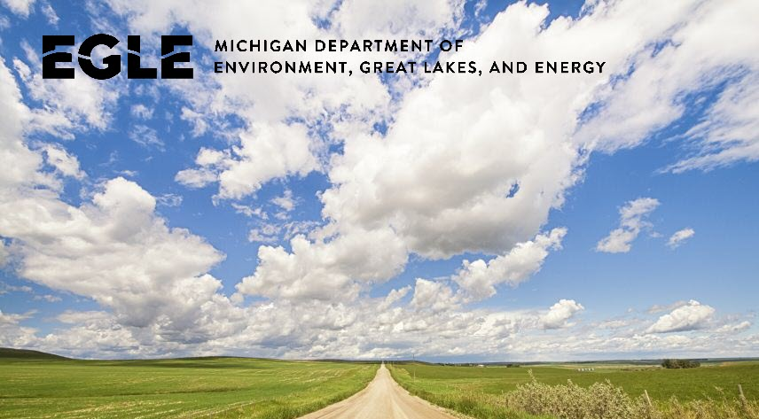
Pillars of Compliance and Enforcement
Timely
Consistent
Addresses harm to pubic health/env. and importance to program priorities
Usually progressive in nature
Can initiate enforcement at any time depending on seriousness of violation
Notes:
Promptly after the violation takes place or is discovered. A timely action sends a clear message to violators and have an better ability to respond and correct violation
Appropriate: violation’s affect on program integrity; commitments with EPA; the severity and duration of the violation; any public health risk or resource
damage caused by the violation; the compliance history of the violator; and the willfulness, negligence, and recalcitrance of the violator.
A consistent compliance and enforcement program provides the regulated community with the benefit of knowing what to expect from the DEQ when violations occur. Aconsistent approach also ensures a level playing field for all regulated entities.

Slide 4
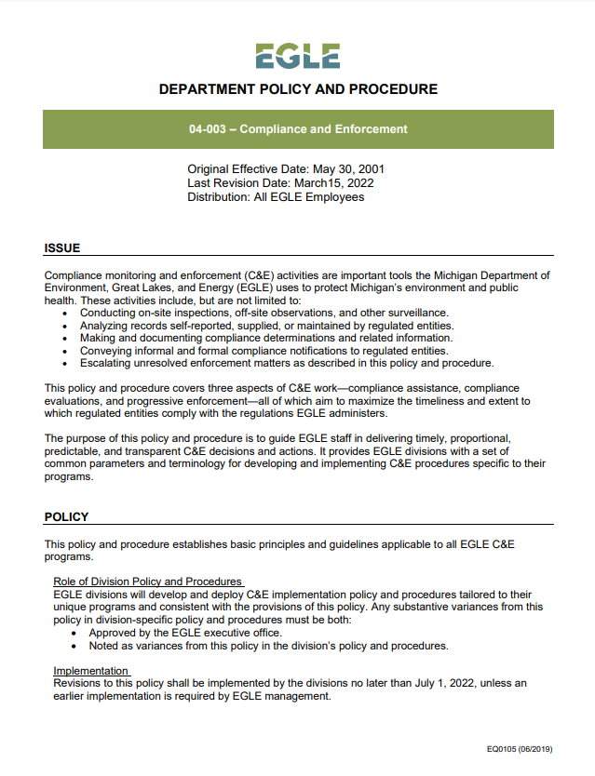
EGLE Compliance Enforcement Policy & Procedure
Goals:
Cross division consistency
Efficient and timely resolution of violations
Create public and regulated community expectations
Applies to all C&E activities in EGLE
Divisions are updating procedures to align with goals of policy
Effective Date: July 1, 2022

Slide 5
Key Changes
Formalize procedures for documenting violations
Tracking when violations are resolved
Establishes procedures and timeline for referring violations for enforcement and reaching a settlement
Notes:
Enforcement Unit strives to achieve the proposed settlement agreement in concept w/in 180 days of referral
Enforcement Unit must notify AQD management team of inability to resolve by day 180 and seek an extension

Slide 6
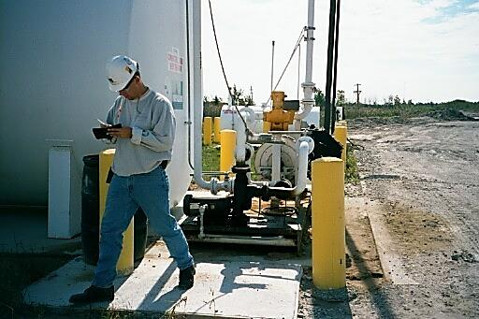
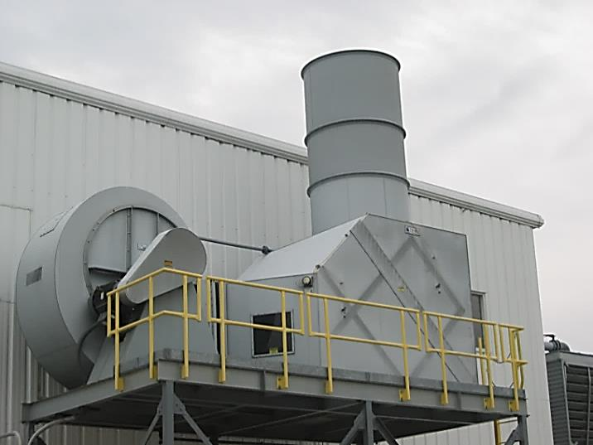
How are facilities chosen for inspections?
Follow EPA Compliance Monitoring Strategy and State Targets
Targeting
Inspector Initiated
Citizen complaints
Air monitoring stations
Can be Unannounced or Scheduled

Slide 7
Significant Violations for Enforcement
High Priority Violations per EPA policy
Violations ongoing or repeated
Violation(s) are of significant scale, scope, duration or frequency
Violations pose a potential risk to public health or environment
Certain Asbestos violations
Emissions exceed certain emission limits in permits
Violator is unresponsive or uncooperative at resolving the violations
Notes:
Highlight that there may be state rules only EGLE can enforce and federal rules that only EPA can enforce

Slide 8
Multi-media
C&E policy includes guidance on what district staff should do when multiple violations across divisions
Can be advantageous for EGLE to consolidate these violation(s) into one enforcement action rather than separate actions
Regular coordination, communication and follow through is critical

Slide 9
AQD Enforcement Process
Legal process to resolve a company’s air quality violations that includes issuing a Consent Order
Legally binding contract that AQD enforces
Contains a compliance program that the company must follow
Requires the payment of a fine and stipulated fines for future violations
What is a Consent Order?
Notes:
Escalated enforcement is the legal process which we use to resolve violations that were cited and sent to enforcement
Resolve through administrative consent order
ACO is an administrative settlement – legally required to offer this to a company in enforcement before we consider DAG or EPA
Contains compliance program, fine, stips
90% of violations in enforcement resolved through ACO

Slide 10
Enforcement Action Legal Documents
Administrative Action
95% of cases resolved with Consent Order
Civil Action
Consent Judgement (state action with DAG)
Consent Decree (joint State and federal action involves Department of Justice and DAG)
Notes:
AFO
In certain instances, EU staff may issue an AFO rather than an ACO to resolve an enforcement action. EU staff will consult the February 2006 AQD Guidance
EU staff will discuss with District staff whether an AFOs may be considered in certain enforcement cases before offering an AFO to a regulated entity to resolve the alleged violation(s).
AFO no compliance plan, stipulated penalties for future violations and no 30-day public notice and comment.

Slide 11
Partnering with EPA on Enforcement
Talking regularly and meeting bimonthly to discuss enforcement cases in Michigan
Joining together on certain cases to address significant long term violations
Assisting with ambient air monitoring to evaluate public health concerns
Providing guidance and technical expertise on challenging air quality issues

Slide 12
Community-Based Inspections
EPA initiative to target and inspect sources in targeted geographical EJ areas
Flint, NE Detroit, have been completed
AQD coordinating with EPA on these inspections and potential enforcement actions

Slide 13
Where is Environmental Justice Incorporated Into our Work?
Permitting
Monitoring
Enforcement
Special Projects
Outreach and Communication
Notes:
Environmental Justice is incorporated into the work we do at EGLE. EPA has had a focus on EJ this fiscal year. They have been coming out with new guidance as a way to assist state agencies with incorporation of Envronmental Justice considerations into our day to day work and decision-making.

Slide 14
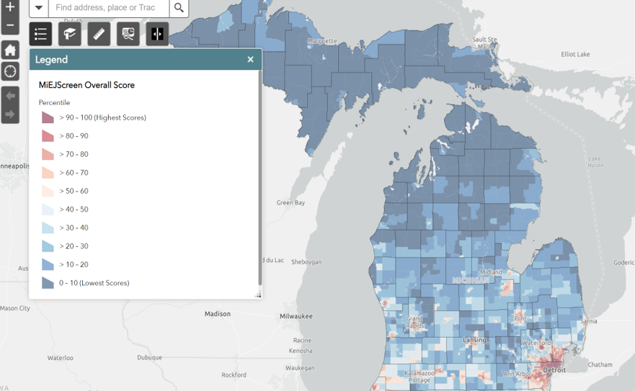
Engagement and Translation
Environmental Justice
Enhanced Outreach
Translation
Michigan.gov/EnvironmentalJustice
Notes:
A few highlights of EGLEs EJ Work include –
Public Participation Policy and Procedure
Nondiscrimination Policy
Limited English Proficiency Plan
Cumulative Risk Assessment
MI EJScreen
Specific to AQD –
Public Participation
Preparation
Review of EGLE Policies
Public Participation
Limited English Proficiency
Nondiscrimination
Communications Plan Prep
There is no regulatory or statutory lever in place
How do you envision EJ impacting agency decision-making? - No hard and fast answer on how it will be used; not there yet; welcome feedback
In use to help inform outreach, translation, etc.
Do you anticipate specific rules or policies from AQD that will address EJ impacts on AQD business?
Policies perhaps, not there yet
As EJ is a priority both at the state and national levels, we can expect to see more on making EJ principles part of our culture.
Given all of the positive downward trends for emissions (e.g., like the NAAQS), how can AQD (and others!) communicate this more effectively to the public?
Excellent comment and would welcome ideas
How to reconcile the downward trends in regional air quality with peoples on the ground exposures and experiences
Recognizing everyone has a different level of familiarity with air quality rules, regulation, and procedures, EGLE AQD strives to provide easy to understand information for the public.
Our work is very “sciency” – how to share to understand; teach not preach; find areas of common ground, seek new and innovative ideas, etc.
Always seeking input into the effectiveness of our work
Are there any significant air-related issues that ECOS is addressing on behalf of multiple states?
ECOS is working on many things including EJ, sensor and monitoring technologies, climate issues and GHG regulations
EGLE is committed to allowing the public to have meaningful engagement in the public participation process and achieving equity and transparency as we interact with the public.

Slide 15
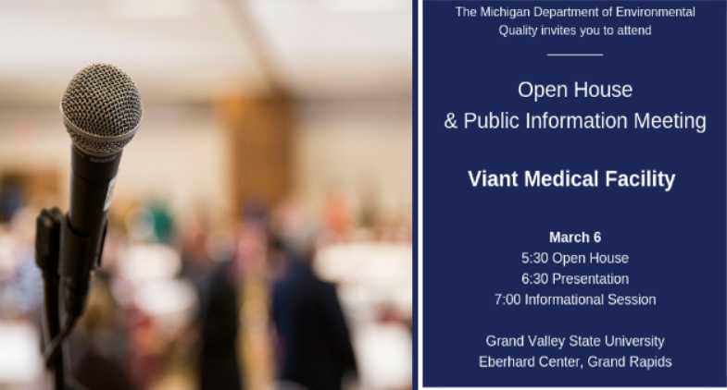
Community Engagement
Increasing Public Outreach
Dedicated websites, regular meetings, holding public hearings on controversial enforcement actions
Proactive
More Townhall meetings, including translation services
Timely in responses to public concerns
Regular updates to public regarding a compliance or enforcement action

Slide 16
Recent Odor Cases
Increase in nuisance odor complaints from various sources across the state resulting in more enforcement cases
Usually multiple Violation Notices issued due to ongoing complaints by residents
Negotiations can take time due to determine the most effective measures to address the odors and control may be necessary which can trigger the need for a permit.
Nuisance Minimization Plan for Odors: Focused on compliance schedule to reduce odors and respond to community concerns
Controversial nature of the case can lead to holding a public hearing on the proposed consent order
Consent Order may also include a Supplemental Environmental Project

Slide 17
Supplemental Environmental Projects
What is a Supplemental Environmental Project?
Example projects
Install Building Management Systems and air filters to improve indoor air quality at community centers, schools
Plant trees to buffer pollution
Improve energy efficiency
Install fence line monitors
Voluntary environmental or public health project
Required as part of enforcement action
Most of fine invested into project
Notes:
Legally required to complete
BMS = Automated energy control platform that allows for remote monitoring and management of building systems.
-identified by the Detroit Public Schools as a project in need that had not been funded
The building systems that will be controlled include lighting, mechanical and water systems, heating and cooling, and ventilation.
Monitor, in real time, how well the systems and equipment are performing
Control ventilation, temperature, and humidity to make the building more comfortable
Overall, higher energy efficiency, lower operating and maintenance costs will result in cost and energy savings for the school
Brewer Park
partner with The Greening of Detroit - required to plant over 80 trees in Brewer Park
This park was identified as one that could benefit from more trees
It is required that the trees will be maintained and watered for 2 years
And any trees that do not survive will be replaced.
Paying $212,000 for 2 projects

Slide 18
800-662-9278 | Michigan.gov/EGLE
Jenine Camilleri, Air Quality Division
camillerij@Michigan.gov | 517-643-2612
Notes:
With that … I’ll stop and if we have time, answer any questions.
What are we looking forward to in 2023?
Air Quality Division's core work will continue.
This includes permit writing, inspections, enforcement actions, air monitoring, emissions testing and reporting, responding to Freedom of Information Act requests, and employee training, as well as review and updates of toxic air contaminants and rules, when necessary.
As our technology becomes more outdated, the Division is working to implement a new electronic platform to help us manage data and documents. The system will help the Division work more efficiently and aid in our transparent communication with communities and businesses.
While some of our technology is getting an upgrade, other technology focused on air sampling and monitoring is looking to the future. The Division is using new measuring devices to further assess compliance at some facilities.
The Division will also be continuing to work with various groups on ozone and sulfur dioxide nonattainment issues in some areas of the state.
Continued improvement in communicating with the public on air quality issues will remain a priority for the Division. Equitable and inclusive communication with Michigan residents about air quality is more important than ever.
The Division is constantly looking to ways to involve interested residents in ongoing actions by staying involved with the Office of Climate and Energy and the Office of the Environmental Justice Public Advocate .
The Air Quality Division staff will continue to be available to residents for conversations about air quality, one on one, through training and outreach, and working with partners representing all stakeholder groups.

