Slide 1
Emergency Spill Response-Contractor Basics.
Donald D. Long-Director of Emergency Response

Slide 2
Role of the Cleanup Contractor
Gather critical initial information from Emergency Services (Police & Fire).
Ask the right questions (What, how much, where did it go??) before mobilizing.
Provide a realistic ETA.
Interact with 911 Dispatch/client(s) en-route, and locate Incident Command upon arrival.
Hold a safety briefing and tailgate meeting.

Slide 3
Role of the Cleanup Contractor
Provide “general contractor” style guidance and insight. Assess the spill and communicate a coherent, structured approach to the client. Assume this is their first haz-mat experience.
Provide documentation (timelines, site maps, floor plans, area(s) impacted, etc.)
Ensure applicable state/federal officials have been notified, and communicate potential risks (direct or indirect) to employees or general public.

Slide 4
Role of the Cleanup Contractor
Offer to contact a reputable, qualified consultant to provide field screening, sampling services, & report production.
Establish work zones for personnel on-site. Meet or exceed the minimum required level of CPC (based on the chemical risk) and provide real-time air monitoring.
Recover the released material, and assess the affected area(s).

Slide 5
Role of the Cleanup Contractor
Properly containerize, label, & secure waste containers pending disposal.
The contractor does not have authority to clear public spaces or structures for public re-occupancy.
Clearance for re-entry and occupancy must be provided by the applicable local or state health department, or USEPA representative.

Slide 6
The “Small” Release
Less than 5 gallons (est. 50 lbs) of product.
Confined to a minimal area (van trailer, non-flowing ditch, road shoulder) but no waterways or storm drains.
No migratory pathways are impacted. Verify & document with applicable monitoring equipment and/or sample collection.
No “off-site” contamination (e.g., vehicles, residences, or businesses).

Slide 7
The “Medium” Release
5-50 gallons (>50 lbs.) of product.
Still confined to one minimal area
Migratory pathways potentially impacted (based on visual observation & client info).
Potential “off-site” contamination (e.g., vehicle and/or pedestrian traffic).
Potential release to waterways (storm drains, sewers, or ditches).

Slide 8
The “Large” Release
50-250 gallons (100-plus pounds) product.
Not confined to one area, spreads quickly.
Migratory pathways clearly impacted (visible stains, obvious odors).
Definite “off-site” contamination (e.g., vehicle & pedestrian traffic, multiple properties).
Suspected release to waterways (storm drains, sewers, or ditches).

Slide 9
The “XL with Fries” Release
> 50 gallons (>500 lbs.).
A petroleum product, corrosive, or water-soluble product (pesticide, ethanol, etc.)
Migratory pathways clearly impacted…you can see it upon arrival. Multiple phone reports from public and/or businesses.
Off-site contamination a certainty.
Released to a waterway (storm drain, sewer, or ditch).

Slide 10
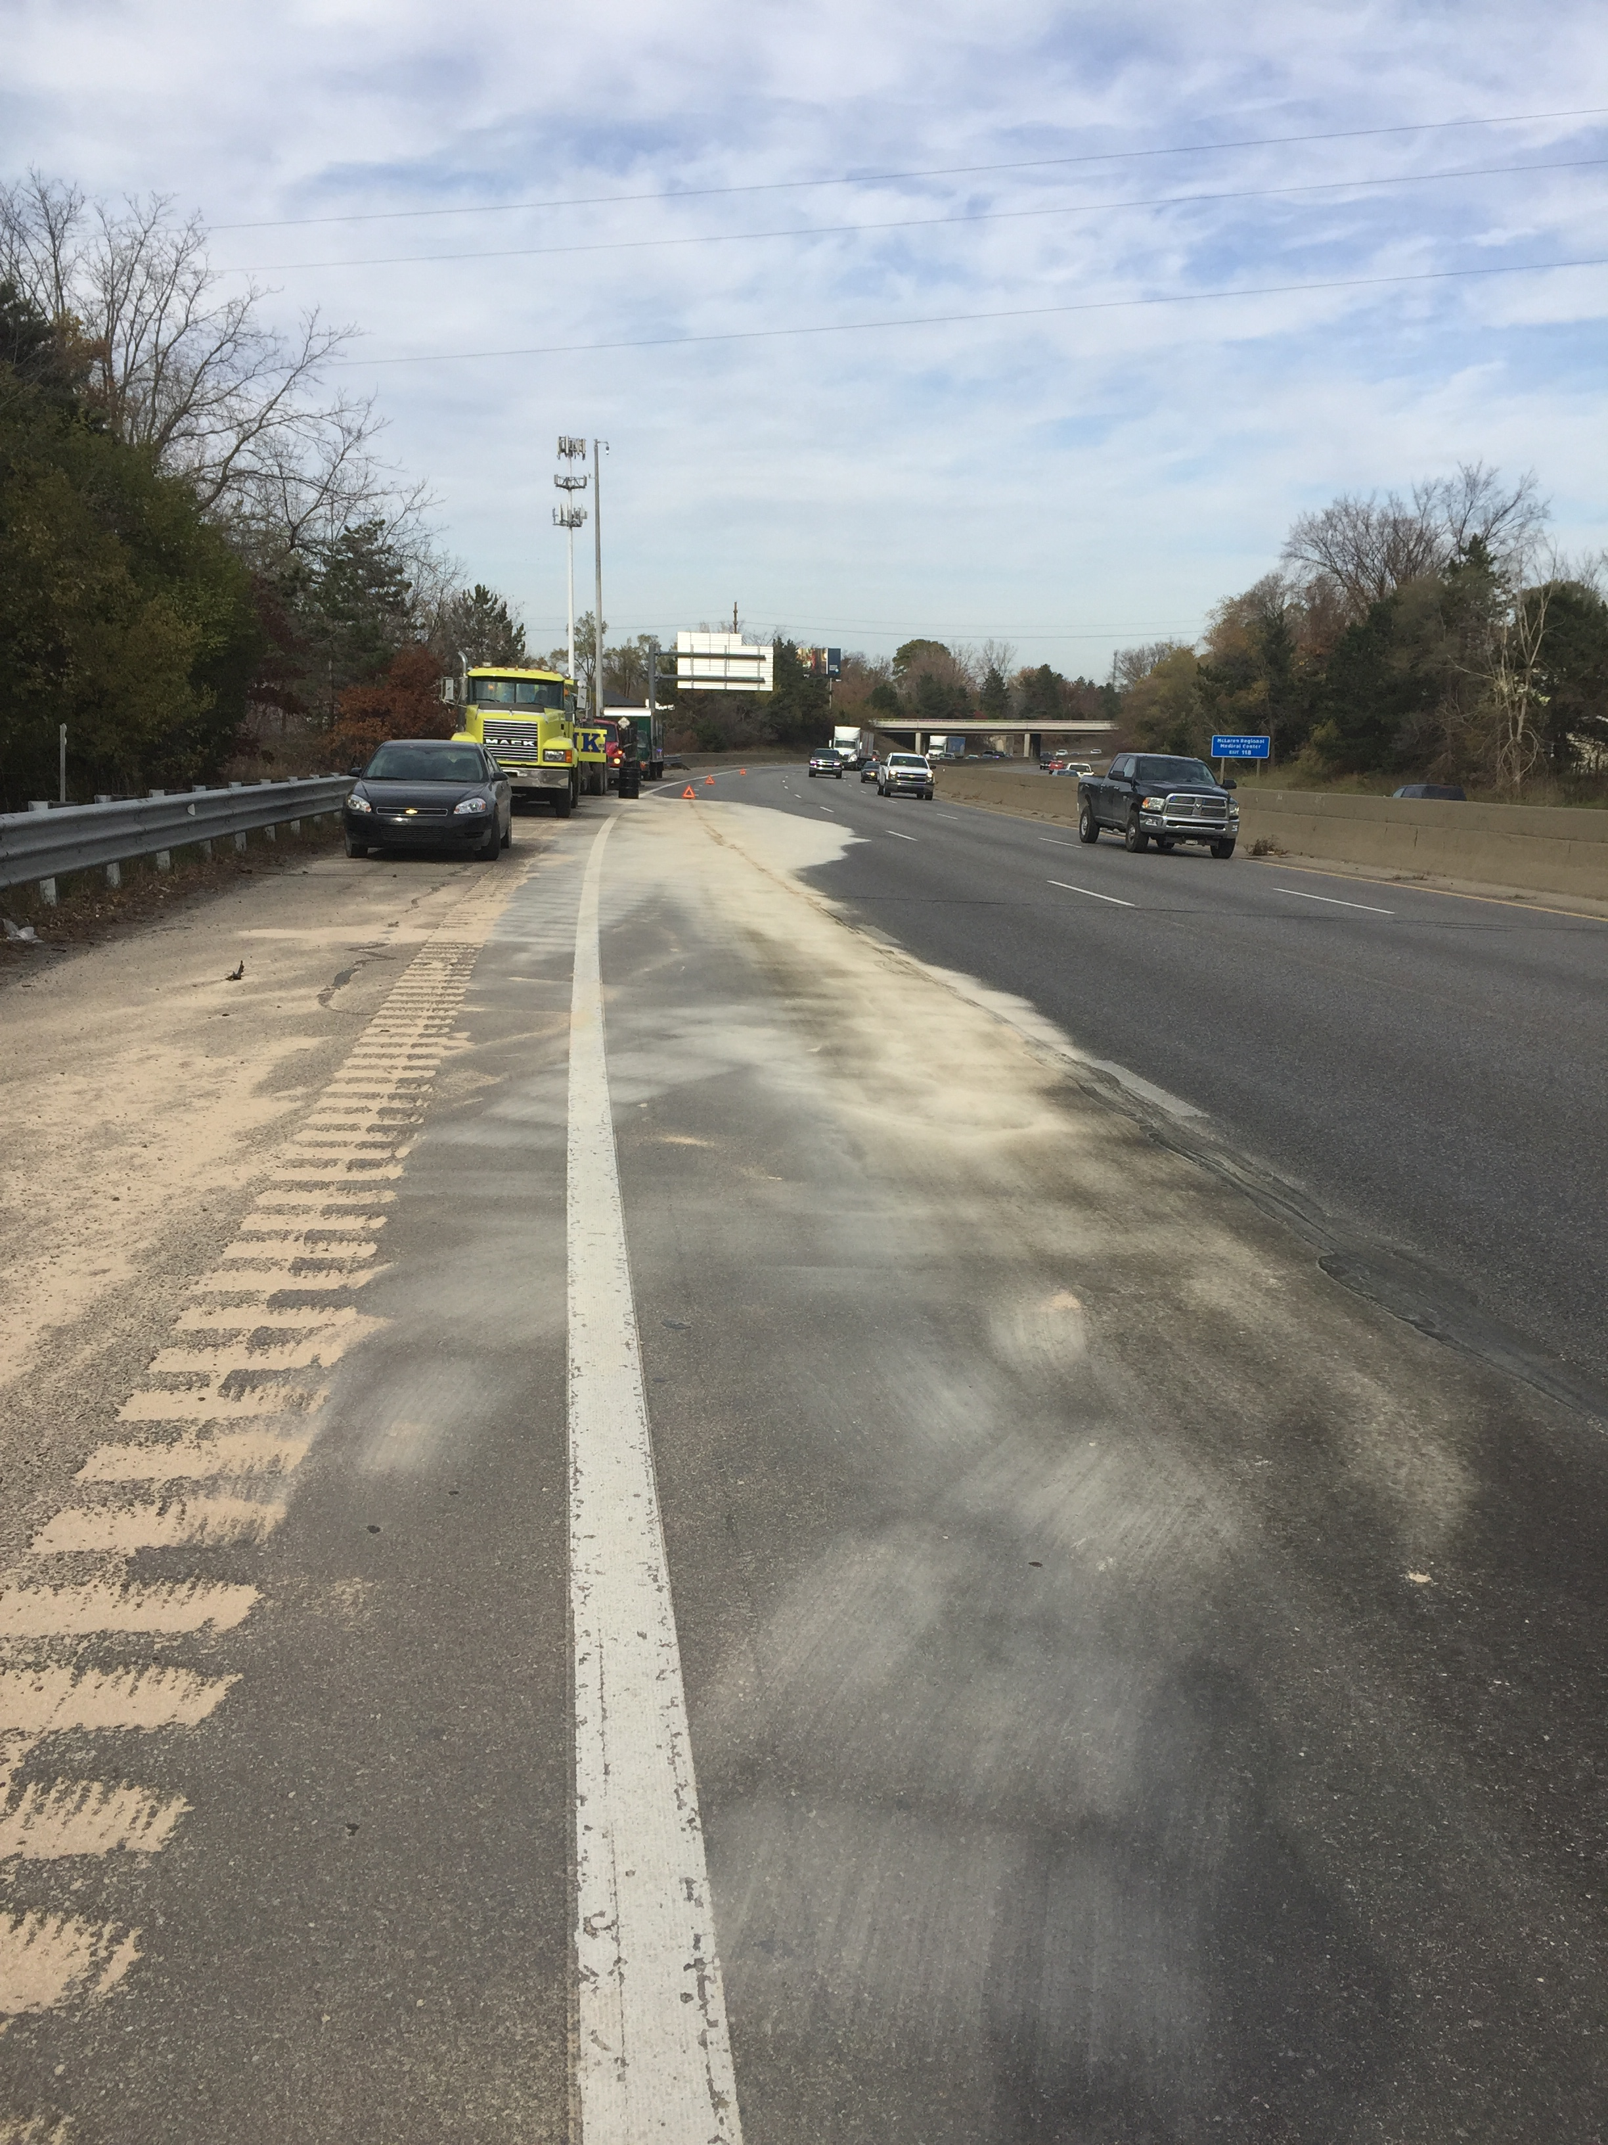
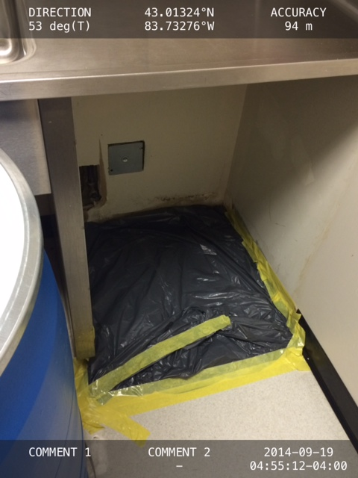
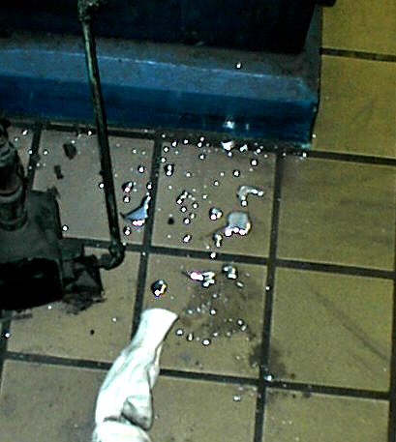
Photographs (small spills)

Slide 11
Example-The Large Spill
A Port Huron school-Morning, Fall of 2014. Student brought Hg onto a school bus where it spilled. Was then tracked into the school.
Upon discovery, school administrators gathered all students (and their belongings) that rode the bus. All were isolated and Local Health Department officials & EPA notified.
Impacted bus was parked & secured.

Slide 12
The Large Spill-Continued
School officials contacted cleanup contractors.
School was promptly shut-down.
Initial field screening performed by Health Department officials. Would be continued by EPA consultants until cleanup completion.
HVAC system shut-down to enable accurate field screening (identify migratory pathways).

Slide 13
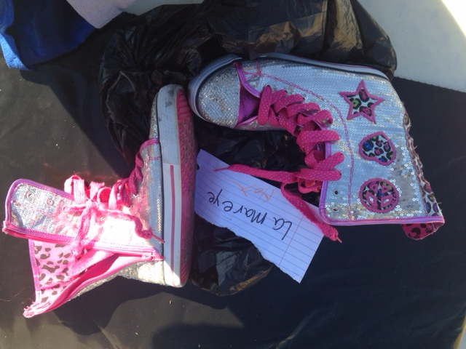
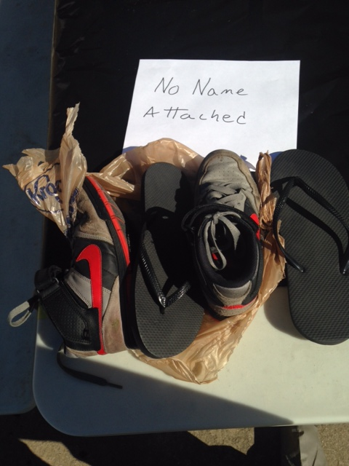
Photographs (Personal Items)

Slide 14
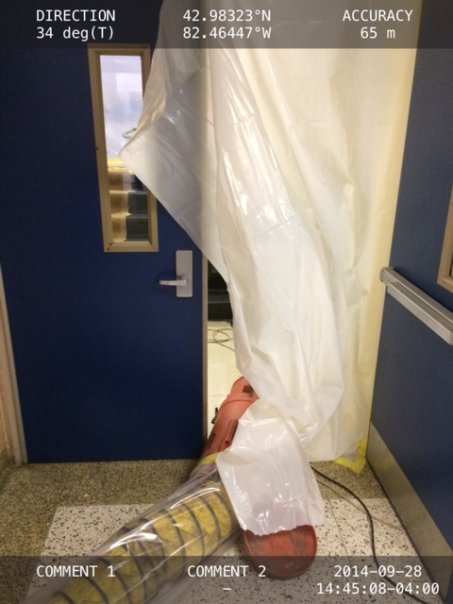
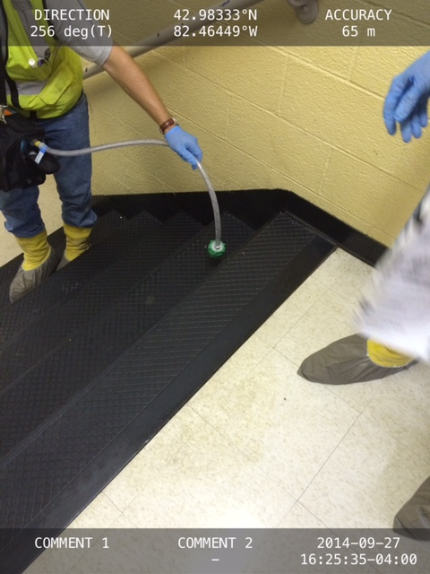
Photographs (screening)

Slide 15
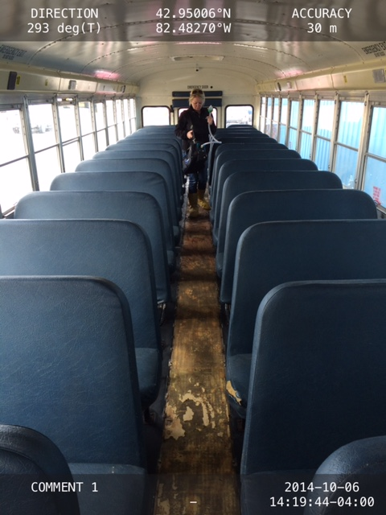
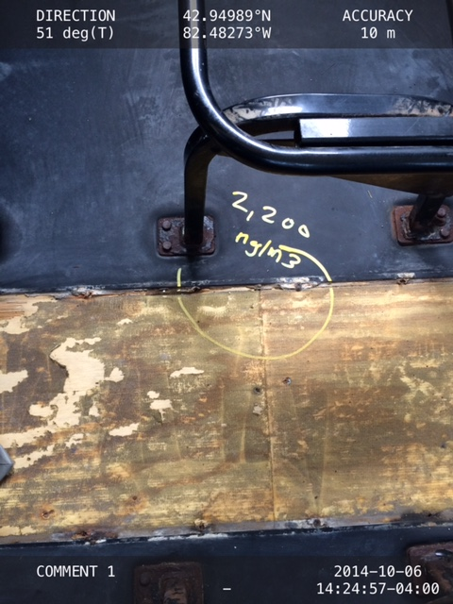
Photographs (HG Bus Decon)
Notes:
Based on existing TDG requirements, changes were made to address needs of other sectors.

Slide 16
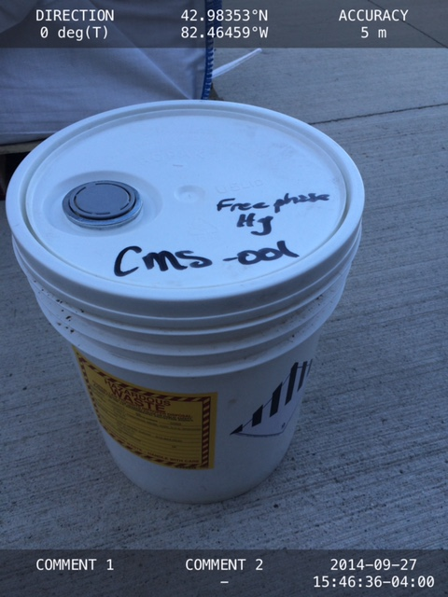
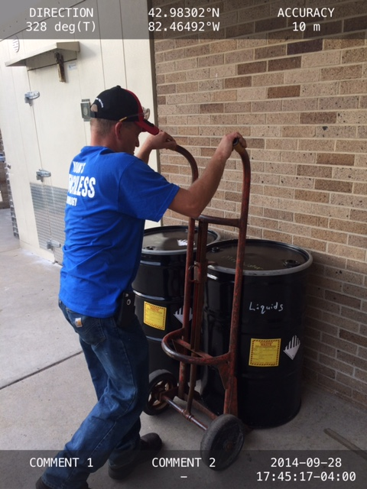
Photographs (The Waste)
Notes:
Focal Point: UN Committee of Experts on Transport of Dangerous Goods, in cooperation with the ILO.

Slide 17
The “Large” Release-Hours Worked & Costs (HG Spill)
Total YECI hours worked-163
Field screening & 8-hour air sampling services provided (NIOSH 6009).
Disposal-2 cubic yard boxes, 8x55-gallon drums, and 2x5-gallon pails with free phase Hg (approx. $ 3,000.00)
Total Cost $ 25,500.00

Slide 18
Photographs-Parking Lot

Slide 19
Intermodal Containers

Slide 20
Stainless Steel Tankers

Slide 21
Soil Excavation

Slide 22
Leaking Tankers

Slide 23
Bulging Drums

Slide 24
GPS Fleet Tracking

Slide 25
Diaphragm Pumps
WILDEN T15 (3”) Metal Diaphragm Pump.
Used for Petroleum Products & Non-Corrosive Liquids.
186 GPM (704 LPM) Maximum Output.

Slide 26
Diaphragm Pumps
WILDEN (3”) Polyethylene Diaphragm Pump
Used for Corrosives (acids- caustics) & Hypochlorites.
186 GPM (704 LPM) Maximum Output.

Slide 27
Questions?

